Slide 1

20EC5203 ELECTRONIC DESIGN PROJECT- I
Presented by:
NAGALAKSHMI S (811722106060)
POOJA S V (811722106074)
RICHIE ALBINAA A B (811722106087)
Under the Guidance of
Dr .S . Monisha
Assistant Professor/ECE
Electronics and Communication Engineering

Slide 2
OUTLINE
ABSTRACT –MODULE 1
INTRODUCTION
OBJECTIVE AND SCOPE
BLOCK DIAGRAM
HARDWARE MODULE
ADVANTAGES AND APPLICATIONS
ABSTRACT –MODULE 2
INTRODUCTION
OBJECTIVE AND SCOPE
BLOCK DIAGRAM
HARDWARE MODULE
ADVANTAGES AND APPLICATIONS
CONCLUSION
REFERENCES

Slide 3
MODULE 1 - CLAP ACTIVATED LOCATOR DEVICE

Slide 4
ABSTRACT - MODULE 1
The “Clap-Activated Locator Device” is an innovative solution designed to help users quickly locate small, frequently misplaced items such as TV remotes, keychains, or wallets. This device uses a sound detection module that identifies the distinct sound of a clap. Upon detection, it activates an alert mechanism, such as a buzzer or LED, to signal the location of the object. The device is compact, lightweight, and easily attachable to various items, making it highly versatile and user-friendly. By employing simple yet effective technology, it eliminates the frustration of searching for lost objects and enhances daily convenience. This project demonstrates the practical application of sound recognition technology to solve everyday problems. With potential for further customization and improvement, the Clap-Activated Locator Device offers a cost-effective and efficient tool for modern households and workplaces.

Slide 5
INTRODUCTION – MODULE 1
Misplacing essential items like TV remotes, keys, or small gadgets is a common issue faced by many in their daily lives. The Clap-Activated Locator Device addresses this problem through an innovative, user-friendly solution. This device is designed to respond to the sound of claps by activating an alert system, such as an LED indicator or buzzer, to help users quickly find their lost items. By employing sound recognition technology, the device ensures simplicity and efficiency. Its customizable features allow it to adapt to various objects, making it versatile for different scenarios. This project combines practical engineering concepts with real-world usability, showcasing how technology can simplify day-to-day challenges. The Clap-Activated Locator Device is particularly valuable for individuals who often misplace small items or for those with physical limitations that make searching more difficult. This project not only demonstrates technical innovation but also emphasizes user-centered design to enhance convenience and productivity.

Slide 6
OBJECTIVE AND SCOPE
OBJECTIVE
The primary objective of the "Clap Activated Locator Device" is to assist users in quickly and efficiently locating misplaced objects, such as keys, remotes, or gadgets, using sound-based activation. By detecting the sound of claps, the device will produce a response (e.g., beep or light) to guide the user to its location.
SCOPE
Applications –Every day Usage, Elderly and disabled Assistance, Industrial /workspace Use
Technology and Functionality - Sound Detection, Signal Response, Range, Noise Filtering
Design Considerations - Compact and portable size

Slide 7
LITERATURE SURVEY
Authors | Title | Year | Methodology/Components | Pros | Cons
Kumar, A., Sharma, P., & Singh, R. | Design and Implementation of Sound-Activated Control Systems | 2020 | Utilized sound recognition sensors, signal amplifiers, and microcontrollers for control systems. | Cost-effective, easy to implement, applicable in various environments. | Susceptible to noise interference and false triggering.
Patel, R., Desai, M., & Agarwal, N. | Human-Sound Interaction for Smart Devices | 2021 | Developed algorithms for sound pattern recognition to enhance human-device interaction. | Improved user-device engagement, adaptable to smart home setups. | Limited performance in noisy environments.
Gupta, P., Verma, S., & Jain, V. | Low-Cost Key Finder Using Acoustic Signals | 2021 | Employed basic components like microphones, amplifiers, and speakers for item location. | Affordable, portable, and energy-efficient design. | Limited to short distances and noise-sensitive.
Singh, T., Rathi, A., & Mehta, S. | Noise-Resilient Sound-Activated Locator Systems | 2022 | Used advanced signal filtering and noise suppression techniques to enhance sound detection. | Reliable performance in noisy settings, reduced false positives. | Increased complexity and cost of implementation.
Tuli, D., Gupta, S., & Kumar, V. | Bluetooth-Based Item Locator Systems: An Overview | 2019 | Reviewed Bluetooth-based systems with an emphasis on range and connectivity. | Wide range, robust against noise interference. | Higher power consumption and cost compared to sound-based systems.

Slide 8
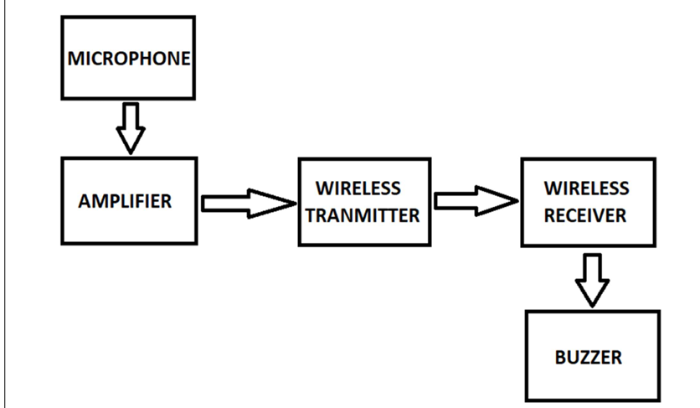
BLOCK DIAGRAM

Slide 9
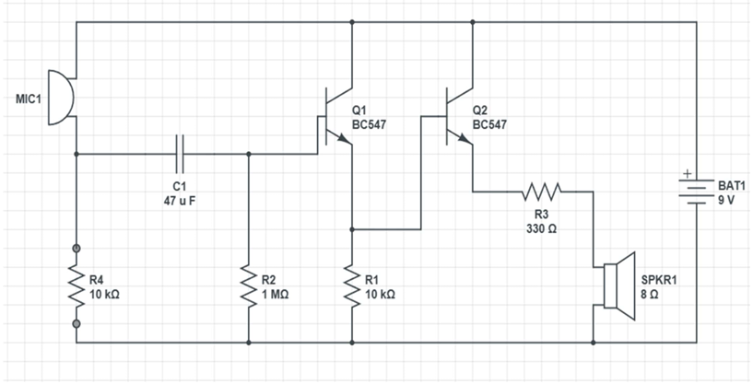
CIRCUIT DIAGRAM

Slide 10
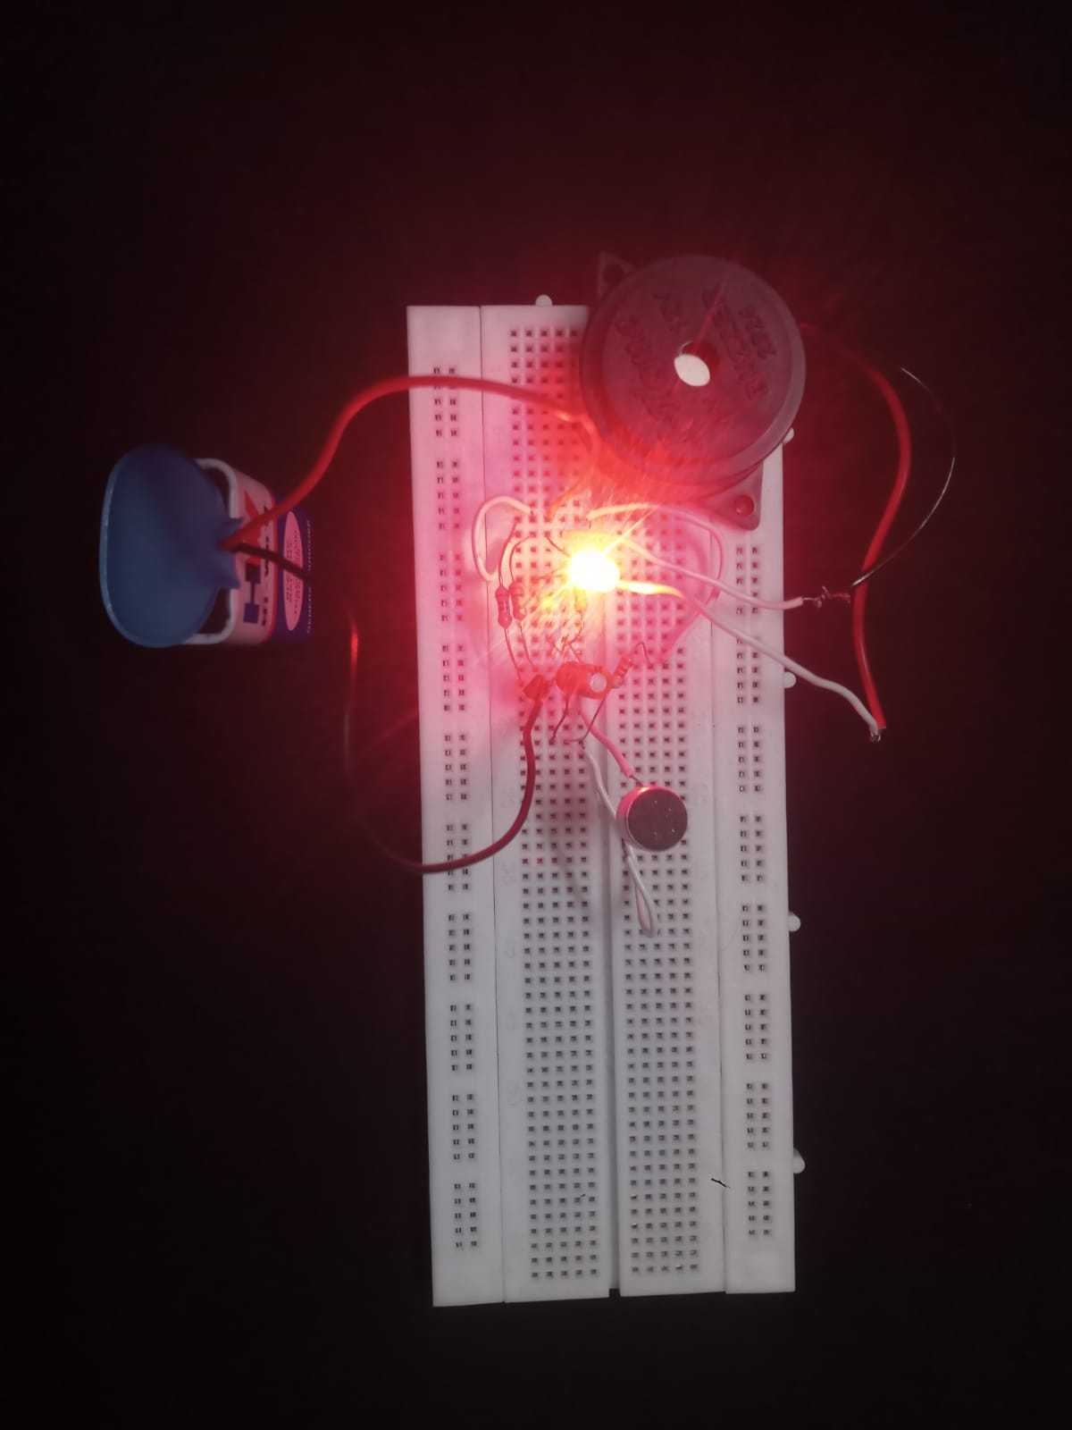
HARDWARE MODULE
https://drive.google.com/file/d/1NqE4QZ2duOQ7j8nOiNGufFpyiKLPrvx0/view?usp=drivesdk

Slide 11
ADVANTAGES AND APPLICATIONS
Ease of Use: Provides a straightforward and user-friendly method to locate a lost remote without needing additional gadgets or apps.
Cost-Effective: Utilizes inexpensive, readily available components, making it an affordable solution.
Energy Efficiency: Can be optimized to have minimal power consumption, ensuring long battery life in the remote control.
Accessibility: Enhances accessibility by offering a simple solution for users with physical limitations, such as those with reduced mobility or vision.
APPLICATIONS:
Smart Home Devices: Can be integrated into smart home remotes or controllers to enhance ease of use and convenience.
Assistive Technology: Beneficial for individuals with mobility or vision impairments, making it easier for them to locate important devices.

Slide 12
MODULE 2 -ANTI SLEEP ALARM GLASSES

Slide 13
ABSTRACT – MODULE 2
Driver fatigue is a major cause of road accidents worldwide, often resulting from long hours of driving and lack of rest. Anti-Sleep Alarm Glasses address this issue by using sensors and algorithms to detect early signs of drowsiness, such as prolonged eyelid closures or head tilting. Upon detection, they activate an auditory or vibrational alarm to alert the user and prevent accidents. Designed for comfort, these glasses are ideal for long-distance drivers and night shift workers. This innovation improves road safety, reduces accidents, and highlights potential for future advancements in fatigue detection technology.

Slide 14
INTRODUCTION - MODULE 2
The Anti-Sleep Alarm Glasses is an innovative wearable device designed to prevent accidents caused by drowsiness, particularly among drivers and individuals engaged in critical tasks. The glasses are equipped with infrared (IR) sensors to monitor the user's eye movements and detect early signs of drowsiness, such as prolonged eyelid closure or reduced blinking rates. When the device identifies these signs, it triggers an immediate alert in the form of a buzzer or vibration, effectively waking the user and preventing potential mishaps. The compact, lightweight design ensures comfort during prolonged use, making it suitable for drivers, machine operators, and other professionals prone to fatigue. This project combines sensor technology with real-time monitoring to address a significant safety issue. By providing an early warning system, the Anti-Sleep Alarm Glasses offers a practical and efficient solution to reduce accidents, improve safety, and save lives.

Slide 15
OBJECTIVE AND SCOPE
OBJECTIVE:
The objective of the "Anti-Sleep Alarm Glasses" is to enhance safety by preventing accidents caused by drowsiness. The glasses aim to detect early signs of fatigue or inattentiveness in users, such as drivers or machine operators, and provide timely alerts to ensure they stay awake and focused.
SCOPE:
Applications- Road Safety, Industrial Safety, Healthcare Support,
Functions and Features- Drowsiness Detection, AlertMechanism, adjustable sensitivity

Slide 16
LITERATURE SURVEY
Authors | Title | Year | Methodology/Components | Pros | Cons
Bhatia, S., & Kaur, P. | Driver Fatigue Detection and Prevention Techniques in Intelligent Transportation Systems | 2018 | Analyzed multiple fatigue detection methods including physiological signals, and AI models. | Comprehensive review of methods, applicability in ITS. | High implementation cost for some advanced techniques.
Zhao, Y., & Guo, R. | A Review on Driving Fatigue Detection Systems Based on Eye and Head Movement Analysis | 2017 | Focused on fatigue detection using cameras for tracking eye blinks and head movements. | Non-invasive, accurate under controlled conditions. | Performance degrades in low light or obstructed views.
Nguyen, H., & Tran, N. | Wearable Drowsiness Detection Systems: A Survey | 2021 | Examined wearable sensors measuring EEG, ECG, and body movement for fatigue detection. | Portable, real-time monitoring, suitable for various users. | Inconvenience of wearing devices for long periods.
Li, C., & Zhou, J. | Smart Glasses for Health Monitoring: A Review | 2020 | Reviewed smart glasses equipped with sensors for health and fatigue monitoring. | Multi-functional, combines health tracking and drowsiness alerts. | Limited battery life and high cost.
Chung, W., & Kim, S. | Driver Drowsiness Detection and Alert System: A Case Study | 2016 | Proposed a drowsiness detection system using both vehicle behavior and driver monitoring. | Reliable by combining vehicle and driver parameters. | Complex integration and dependency on vehicle sensors.

Slide 17
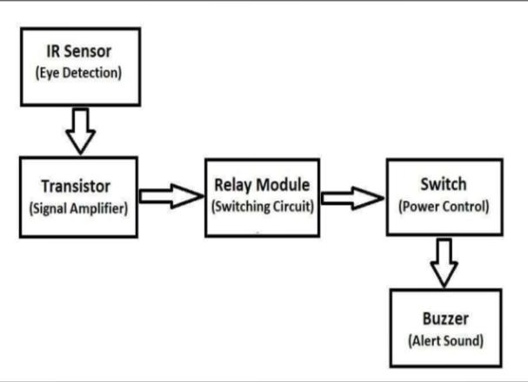
BLOCK DIAGRAM

Slide 18
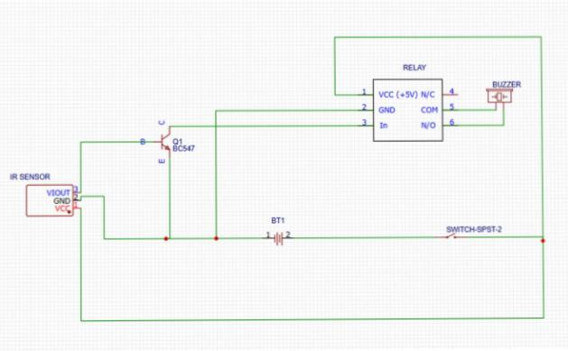
CIRCUIT DIAGRAM

Slide 19
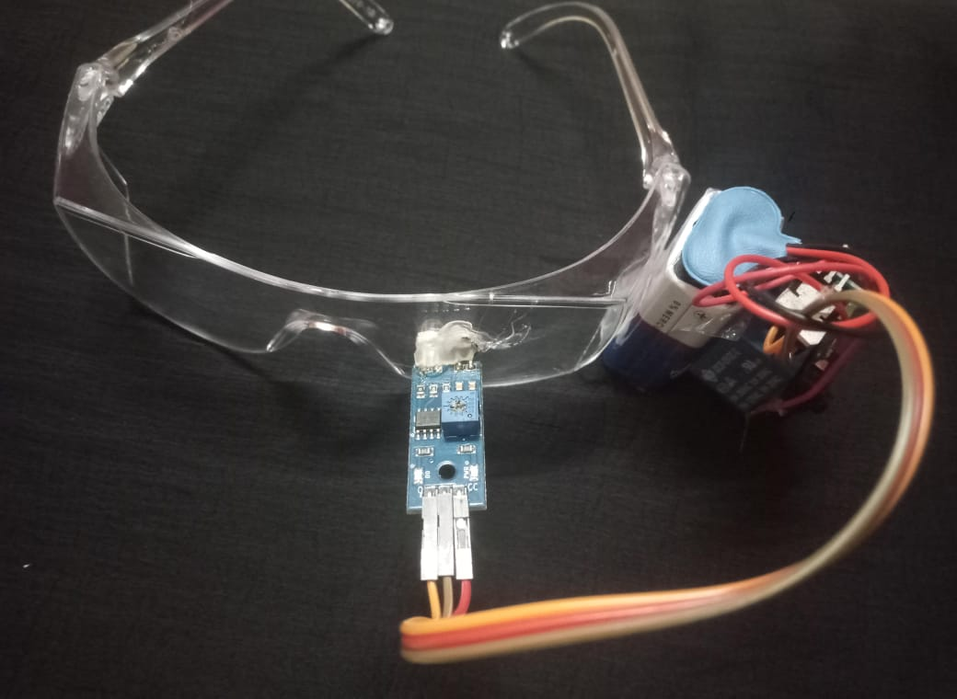
HARDWARE MODULE
https://drive.google.com/file/d/1NtX433sawxSacKK8qprqqx3xYSg3f1bp/view?usp=drivesdk

Slide 20
ADVANTAGES AND APPLICATIONS
Enhanced Safety: Reduces the risk of accidents caused by drowsy driving by alerting the driver before they fall asleep.
Universally Applicable: Can be installed in a variety of vehicles, providing safety benefits for a broad range of users.
Real-Time Monitoring: Provides immediate feedback and alerts, which can be crucial in preventing accidents.
APPLICATIONS
Public Transport: Useful for buses and taxis to ensure that drivers are alert and focused on the road.
Long-Distance Travel: Ideal for long-haul drivers who are at a higher risk of drowsiness during extended periods of driving.
Driver Monitoring Systems: Can be integrated into advanced driver assistance systems (ADAS) to provide an additional layer of safety.

Slide 21
CONCLUSION
The Clap Activated Locator Device effectively demonstrates a practical solution to the common problem of misplacing small or essential items. By utilizing sound detection and microcontroller technology, this device provides a cost-efficient, user-friendly, and energy-saving alternative to conventional trackers. The project showcases the potential for further enhancements, such as integrating wireless connectivity or smartphone compatibility, to increase its usability and reach.
The Anti-Sleep Alarm Glasses project successfully addresses the critical issue of driver fatigue, which is a leading cause of accidents worldwide. By combining sensor-based detection of drowsiness with an immediate alert system, these glasses promote safer driving practices. The device's design emphasizes comfort and portability, ensuring it is practical for everyday use. Future improvements could include advanced AI algorithms for precise drowsiness detection or integration with car systems for enhanced functionality.

Slide 22
REFERENCES
Reddy, M., Kumar, S., & Soni, A. (2020). Sound recognition for object tracking and location in smart environments. Journal of Embedded Systems and IoT, 9(1), 75-84.
Alvarez, R., Martínez, L., & Torres, F. (2022). A review on sound-based location detection systems. International Journal of Computer Science and Applications, 14(4), 321-330.
Sharma, A., & Gupta, R. (2019). Real-time sound classification for object identification in IoT-based systems. Journal of Internet of Things and Embedded Systems, 6(3), 40-50.
Bhatia, S., & Kaur, P. (2018) Driver fatigue detection and prevention techniques in intelligent transportation systems. Journal of Traffic and Transportation Engineering, 5(3), 267-279.
Zhao, Y., & Guo, R. (2017). A review on driving fatigue detection systems based on eye and head movement analysis. Proceedings of the International Conference on Intelligent Transportation Systems, 184-190.

Slide 23
REFERENCES
6. Nguyen, H., & Tran, N. (2021). Wearable drowsiness detection systems: A survey. Computers, 10(2), 45-58.
7. Kumar, A., Sharma, P., & Singh, R. (2020). Design and implementation of sound activated control systems. International Journal of Embedded Systems, 12(2), 110-120.
8. Patel, R., Desai, M., & Agarwal, N. (2021). Human-sound interaction for smart devices. Advances in Smart Technologies, 8(1), 45-58.
9. Gupta, P., Verma, S., & Jain, V. (2021). Low-cost key finder using acoustic signals. Journal of Innovative Electronics Design, 7(4), 89-97. 31
10. Singh, T., Rathi, A., & Mehta, S. (2022). Noise-resilient sound-activated locator systems. International Conference on Embedded Systems and Applications, 15(3), 130138.

Slide 24
THANK YOU

